Slide 1
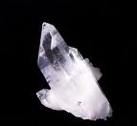
Pizo Electricity
BY: Jonathan Kayne 6th grade
How Quartz is used in Electricity.

Slide 2
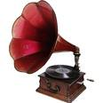
Did you know that Quartz is used in objects of your everyday life?
Quartz ( Moh’s hardiness 7 ) is the most common mineral ever found. It is used in everyday objects such as: clocks, electronic scales, & record players.

Slide 3
Quartz in clocks
Power supley.supply.
Gears
Quartz
Motor
What happens is when a voltage is put upon a piece of Quartz, it vibrates at a precise frequency. The Quartz vibrates 60 times per second, which then creates a pulse, which activates a motor, turns gears, finally turns the clock display.

Slide 4
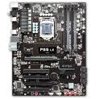
How electronic scales work.
If you squeeze Quartz, it generates a voltage. A scale puts pressure on a piece of quartz, a multimeter reads the amount of voltage in it, & calculates it into weight.

Slide 5
How a record player works.
A record has groves in it with different deepness's. On the record player, there is a needle that rides along the groves. The needle presses on quartz that is connected to a speaker.

Slide 6
THANK YOU!!!!!!

