Slide 1
Geothermal Energy
By:
Jonathan Kayne
Courtney Gianvito
Rhiannon Miller
Hope Sanderlin
Jasmine Angular
ELECTRO-PHOENIX INC.
SEAHAWK CITY COUNCIL

Slide 2
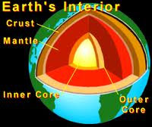
WHAT IS GEOTHERMAL ENERGY?
Geothermal Energy is a type of energy that is harnessed from the heat of the earth.
Geo = Earth
Thermal = Heat
The Earth’s Interior is HOT→

Slide 3
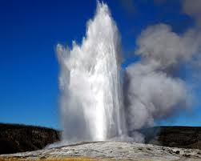
What is the process that we use to obtain geothermal energy?
There are 3 methods used in obtaining geothermal energy, but all use the same method in getting the energy to the surface.
Water seeps/gets pumped down into the Earth and gets superheated where it rises as hot water or steam.
The internal temperature of the Earth is fairly constant.
We will drill into the Earth and install a water piping system; cold water is sent in, hot water comes out.

Slide 4
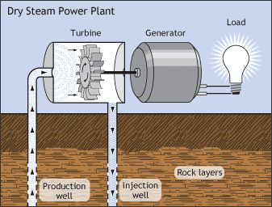
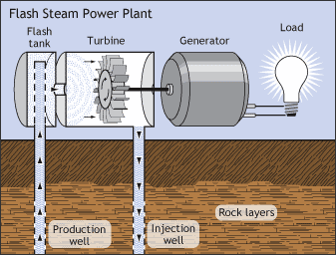
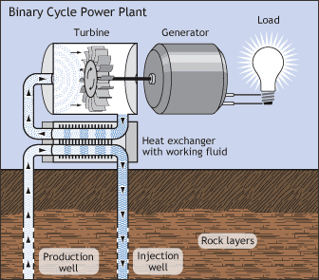
How do turbines transform geothermal into a usable form of energy & where does it go from there?
The heat from the water turns turbines, which can be achieved 3 different ways:
Dry Steam- Water is heated, turned to steam which turns a turbine.
Flash Steam- Fluid is sent into a chamber of lower pressure, causing fluid to vaporize. Produces more energy quicker.
Binary- Hot water is used to heat a liquid with a lower boiling point (such as ammonia) to turn a turbine. This is what we plan on using as it requires less heat to work.
Turbines produce electricity which is sent to homes via power grid.

Slide 5
How does geothermal energy impact the environment? Is it positive or negative?
Geothermal energy has a very minimal impact on the environment. This is because water (steam, liquid, or frozen) doesn’t hurt the atmosphere. Also, the liquids used in the process can be recycled over and over again!

Slide 6
In what ways can geothermal energy be conserved in a green way?
We can send the water to a water treatment facility before releasing it into the environment.
Geothermal energy plant maintenance.
Recycle the water!

Slide 7
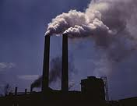
What are the implications of using geothermal energy? Advantages over Nonrenewable?
Nonrenewable energy sources, such as burning fossil fuels, release CO₂ into the atmosphere. Geothermal, on the other hand, doesn’t do this!
Geothermal doesn’t pollute the environment!
Also, with geothermal, you can reuse the water over and over!

Slide 8
References
BOOK- “Energy Alternatives” by Gabriel Gruden ©2005 Thompson Corporation
BOOK- “Geothermal Energy using Earth’s Furnace” by Carrie Gleason ©2008 Crabtree Publishing Company
BOOK- “Geothermal Power” by Neil Morris ©2007 Smart Apple Media
BOOK- “Alternative Energy Sources” by Sally Morgan ©2003 Reed Educational Publishing
ONLINE- www.need.org
ONLINE- www.altenergy.org
MAGAZINE- National Geographic

Slide 9
THANK-YOU
PowerPoint made by Jonathan Kayne
Jingle Composed and Recorded by Jonathan Kayne
Questions by Courtney Gianvito
Answers by Courtney Gianvito, Jonathan Kayne, Rhiannon Miller, Hope Sanderlin, and Jasmine Angular
©2013 by Electro-Phoenix Inc. Commissioned by Seahawk City Council
24 Schneider Ln. Seahawk County, ENKA

