Slide 1
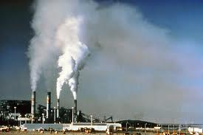
Air Quality
By
Jonathan Kayne

Slide 2
What is air quality?
Air quality is how healthy the air is to breath. This is mainly caused by pollution, which can also affect the Ozone layer, the layer in the Stratosphere that protects us from Ultraviolet (UV) radiation.

Slide 3
What causes bad air quality?
Bad air quality is mainly by pollution such as:
Oil, Kerosene, Gas, Coal, and Wood.
Tobacco products
Pesticides

Slide 4
Affects on the environment
Pollution has caused negative affects on the environment such as:
Unhealthy air.
Global warming.
Ozone depletion.

Slide 5
How to prevent it!
You can reduce air pollution by:
Use air-polluting objects less (which is usually cost-efficient)
Keep moisture away from pollutants. Moisture will absorb it and increase the amount of pollution.
Don’t use objects that pollute over time.

Slide 6
Thanks for watching!
By Jonathan Kayne
http://www.ext.colostate.edu/pubs/consumer/09938.html
http://www.epa.gov/iaq/is-imprv.html
My laptop!
© copyright JZKscience Inc.

