Slide 1
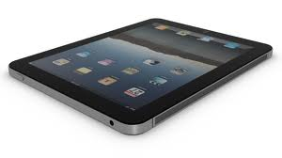
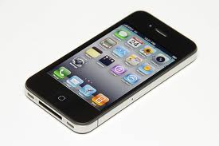
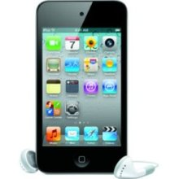
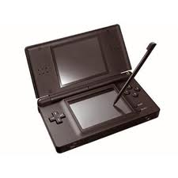
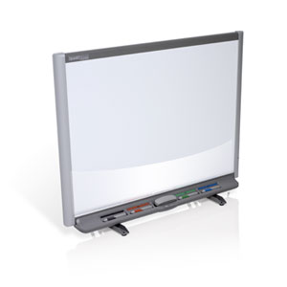
How a Touch Screen Works
By:
Jonathan Kayne

Slide 2
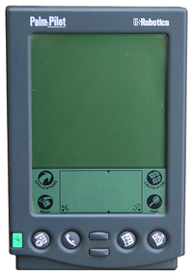
What is a touch Screen?
A touch screen is a circuit that can respond to your touch, and usually has an LCD screen under it that interacts with the touch screen.
The 1st touch screen to be available to the public was called the Palm Pilot invented in 1996.

Slide 3
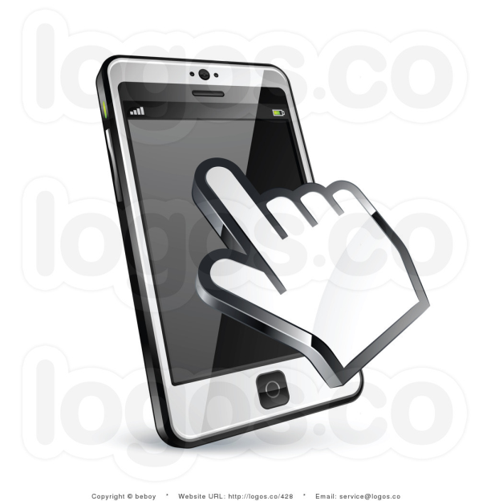
Types of touch screens
There are 3 types of touch screens, 2 of them have been out for a while and are commonly used in our everyday lives.
Resistive Touch
Capacitive Touch
Acoustic Wave

Slide 4
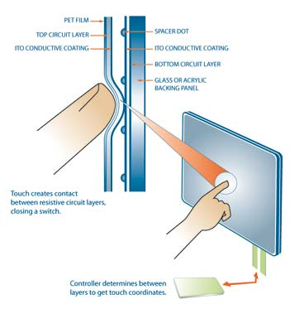
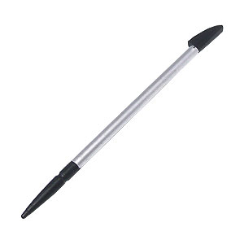
Resistive Touch Screens
Resistive touch screens are used for precision work and use a Stylus, and is used in Nintendo DS, DSi, DSiXL, 3DS, Tablets, Smartboards, and that Palm Pilot.
Resistive touch screens have 3 layers; a positive, a negative and an air layer. The air layer separates the positive and the negative layer and when you touch the screen, positive and negative touch, completing a circuit.
The only problem with a resistive touch screen is that you have to calibrate it.
Positive (+)
Air layer
Negative (-)

Slide 5
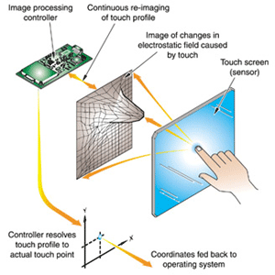
Capacitive touch screens
These are the commonly used touch screens around. With these, you use your finger to work the touch screen. Capacitive touch screens are found in iPads, iPhones, iPod touch’s, Droids, and much more.
Under the screen, there is a grid of very fine wires. (you can see them under the light) When you touch the screen, your finger gets “zapped” in which can be detected by the screen.

Slide 6
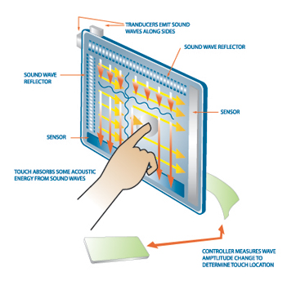
Acoustic wave touch screens
Acoustic wave touch screens use sound waves that bounce off your finger which can be triangulated to find your location. This is a fairly new type of touch screen technology.
This is typically the same as echolocation.

Slide 7
Other types of touch screens
Infrared
Optical Imaging
Dispersive signal technology
More types of touch screens!
Surface acoustic wave
Surface, Projected, Mutual, & Self-Capacitance
Acoustic pulse recognition

Slide 8
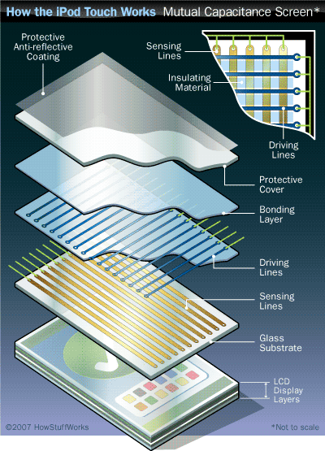
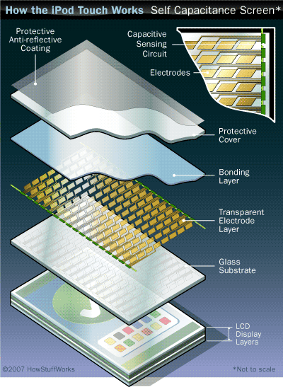
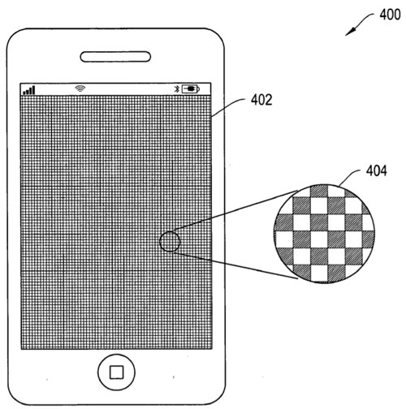
Pictures!!! (iPod touch)

Slide 9
Thanks for watching!!!
By: Jonathan Kayne
www.jkayne.weebly.com
Resources:
http://www.youtube.com/watch?v=ar6VPyWueGk
http://electronics.howstuffworks.com/ipod-touch.htm
http://en.wikipedia.org/wiki/Touchscreen

