Slide 1
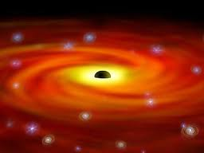
Black Holes
By
Jonathan Kayne

Slide 2
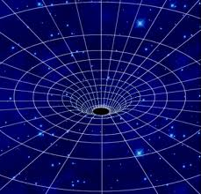
What Is A Black Hole?
A black hole is a point where a dead star has created a dip in time and space. Black holes are invisible because not even light can escape it.

Slide 3
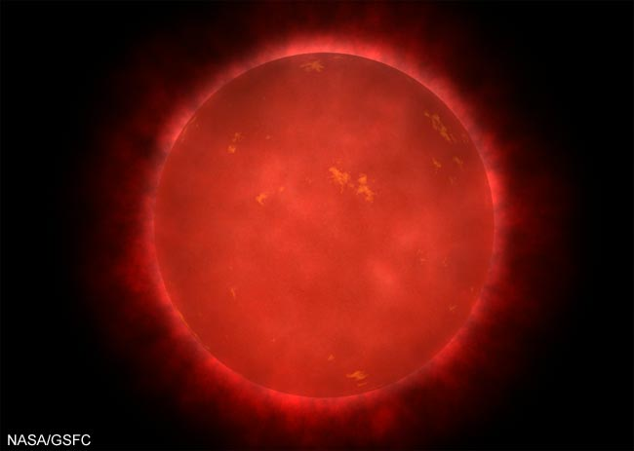
Creation of black holes.
As a star gets old, it starts to expand and explode, turning into a red dwarf. It grows to the size larger than Earth’s orbit.

Slide 4
Creation of black holes.
The elements go through constant changes. As this happens, it starts to loose them. Eventually, its gravity is at 100%.

Slide 5
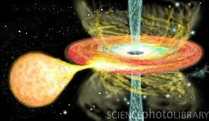
Creation of black holes.
It shrinks to the size of about 1 cm. its size varies from the size of Asheville, to the size of a marble.
It shrinks to the size of about 1 cm. its size varies from the size of Asheville, to the size of a marble.

Slide 6
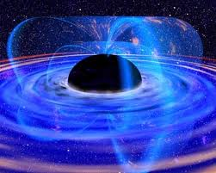
Did You Know?
1 tea spoon (tsp.) is 15,000 pounds (lbs.)
There is a black hole in the center of the Milky Way Galaxy.
Another black hole has a star called v406c orbiting it.
Black holes are detected by X-Rays from object’s getting sucked into it.

Slide 7
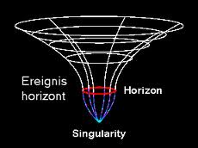
Conditions.
When you enter a black hole, you would feel a tugging on your body. You would be stretched taller. This is called spaghettification.
LOCATIONS
The point where nothing can escape is the event horizon. The point where everything is pulled to is the singularity.

Slide 8
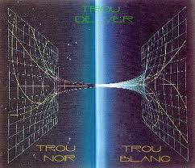
Wormholes.
A wormhole is when 2 black holes meet at their singularity point. This can be used in the future for teleportation.

Slide 9
Thanks For Watching!
By Jonathan Kayne
Special Thanks to Lyubov Nichols, for teaching the class.
UNCA
Super Saturday- Physics is Phun class.
Mr. Hansen
Google
Dell™| Latitude E5410 (My AWESOME Laptop)
:-) :) :o) :] :3 :c) :> =] 8) =) :} :^) :D C:

